Slide 1
Capability Program Executive
Mission Autonomy

Slide 2
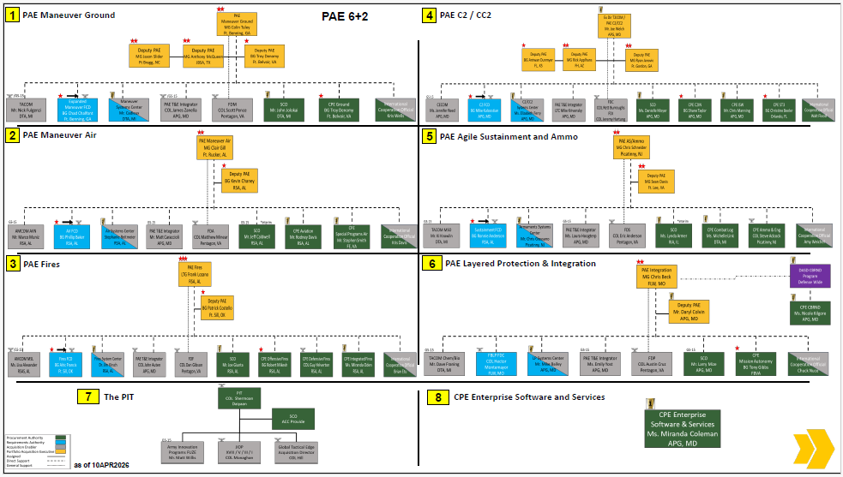
Who We Are
Vision
Empower Soldiers with the full force and scale of American innovation
Success: Design, Validate, Acquire, and Enable synchronized cross-organizational fielding of Formation Based Capability Packages to enable Robotic Enabled Maneuver (REM) via Mission Tailorable RAS Formations (MTRF)
Mission
Increase Soldier situational awareness, lethality, and survivability by delivering interconnected unmanned system capabilities that accomplish missions autonomously and intuitively
Responsible for:
  Development of a unified C2 architecture
  Prototyping against tactical problems/use cases prioritized by T2COM (Autonomy CoN) – Approved 1 JUL
  Development/production of unmanned ground vehicles (UGV) and a portion of the Army's Small UAS portfolio
  Reference architecture and interface standards for Payload, Platform, and Mission Autonomy
CPE Mission Autonomy BG Tony Gibbs (Ft. Belvoir, VA)
Key Stakeholders:
  Army Senior Leaders (ASL)
  Army Chief Technology Officer (CTO)
  All PAEs + PIT
  Key CPEs–C2 (NGC2); Aviation; Ground/Soldier
  DRPM UxS
  Defense Autonomous Warfare Group (DAWG)
  Drone Dominance Working Group (D2WG)
  Army Application Lab (AAL)–xTECH
  Defense Innovation Unit (DIU)
  Joint & International Partners

Slide 3






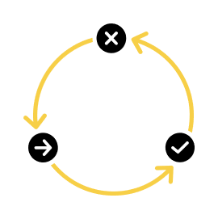



Why Form CPE MA
CPE MA First Principles
Why CPE MA
1. Deliver Formation-Based Mission Autonomy Capability to MBCTs, ABCTs, and SBCTs as the Top Priority
  System of Systems Approach
  Accelerate Robotic Control Architecture
  CI/CD Approach for Autonomy Development
  Identify and address key challenges (power, spectrum, bandwidth, cyber, EW, etc.)
  Address all elements of DOTmLPF-P during prototyping
2. The Soldier Experience is Paramount
  Development and collaboration with operational force
  Intuitive
  Robust/Reliable
  Trainable
3. Close Partnership with Operational Force
  Focus development on relevant use cases with operational units
  Prototype and iterate
4. Develop Sustainable Business Model
  Adopt available industry solutions, Modify when we can, Develop if we must
  Utilize set-based design & selective MOSA approach to maximize competition & industry innovation
  Affordable for the Army
  Profitable for industry
  Foster a healthy and robust industrial base with ability to scale
CPE MA Primer Brief [JULY 2026]
Dominate Future Battlefields
Increase Lethality and Survivability
Optimize the Soldier
Off-load Risk
Leverage Industry Innovation
CPE Key Differentiators
Industry as a Primary Partner
Speed and Iteration
Focus on Scalability
Modular and Open Architecture
Common Control

Slide 4

How We Operate
CPE Mission Autonomy
BG Anthony Gibbs
DCPE
Gary Keller
PAE LP&I
CoS
Michael Foster
CTO
Mike Rose
PM Formation Based Mission Autonomy
O6 CSL = COL John Williams
PdM Mission Autonomy
All Arms Maneuver
O5 CSL = LTC Jack Cooperman
PdM Mission Autonomy
Fires, C2&Counter-C2
O5 CSL = LTC Graham Mullins
PdM Mission Autonomy Agile
Sustainment & Protection
O5 CSL = LTC Jonathan Judy
DOW & Acquisition
APG, MD; Ft. Belvoir, VA
Mission Team: Reconnaissance,
Screening, Breaching,
TSO Emplacement
(1CD Alignment)
Mission Team: Target Identification,
Automated Call-for-Fire, UAS-LM
Hunter-Killer Ops, Range Extension,
Electronic Warfare (4ID Alignment)
Mission Team: Resupply, CASEVAC,
Surveillance, Fixed Site Protection
(25ID Alignment)
Industry
PM Robotic Control
and Integration
O6 CSL = Mr. Rob Monto
Unified C2 Architecture (Collaborative Autonomy)
PM RCI
APG, MD; Ft. Belvoir, VA
PM Autonomous Robotic Capabilities
O6 CSL = COL Ken Bernier
Platforms, Payloads (w/Autonomy)
PM ARC
Operational Force
APG, MD; Ft. Belvoir, VA
Warren, MI; PICA, NJ
Deliver Capability Packages
Operational Force

Slide 5
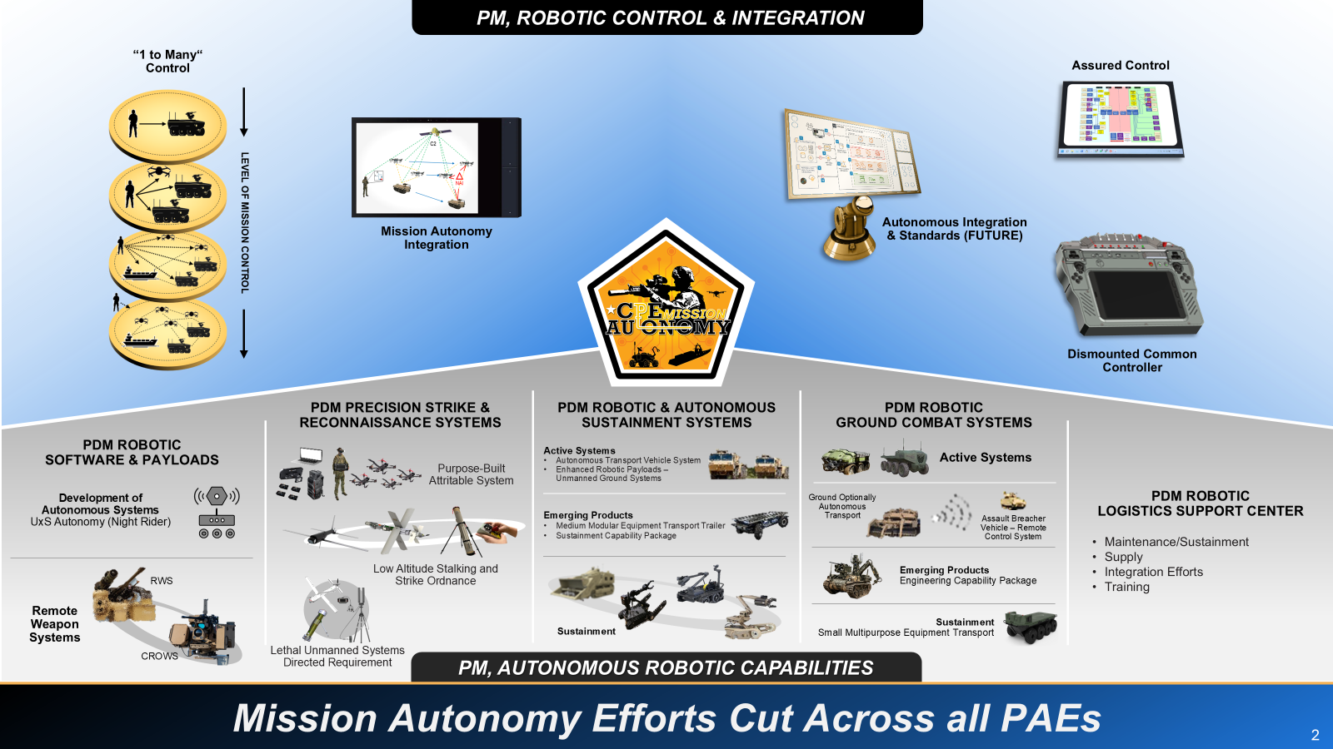
What We Do
Success Defined: Design, Validate, Acquire, and enable synchronized cross-organizational fielding of Formation Based Capability Packages to enable Robotic Enabled Maneuver (REM) via Mission Tailorable RAS Formations (MTRF)

